Slide 1
PENALTY AUTOMATION

Slide 2
PENALTY AUTOMATION
B
C
D
IDENTIFIED
MATERIAL VARIANCE
CREATE NTC
(Notice to Contractor)
POWER AUTOMATION
(Notice of Violation)
DECLARE RETURN/S
RESOLVE
VARIANCE
Yes
WITH
COMMITMENT?
CREATE DMCR
(Debit Memorandum Creation Request)
No
D
VARIANCE MONITORING
COMMITMENT DATE
10 DAYS DEADLINE
No
DMCR
APPROVED?
Yes
A
RESOLVE
BACKJOB
Yes
WITH
BACKJOB?
C
No
VARIANCE
RESOLVED?
E
VARIANCE CLEARING REQUEST
No
Yes
B
WO CLOSING
E

Slide 3
PENALTY AUTOMATION
IDENTIFIED
MATERIAL VARIANCE
DECLARE RETURN/S
D
VARIANCE MONITORING
A
RESOLVE
BACKJOB
Yes
WITH
BACKJOB?
No
B

Slide 4
B
CREATE NTC
(Notice to Contractor)
RESOLVE
VARIANCE
Yes
WITH
COMMITMENT?
No
COMMITMENT DATE
10 DAYS DEADLINE
E
C
No
VARIANCE
RESOLVED?
F
Yes
WO CLOSING

Slide 5
C
D
POWER AUTOMATION
(Notice of Violation)
RESOLVE
VARIANCE
Yes
WITH
COMMITMENT?
No
CREATE DMCR
(Debit Memorandum Creation Request)
COMMITMENT DATE
10 DAYS DEADLINE
No
DMCR
APPROVED?
C
AUTOMATIC NOV
(Notice of Violation)
No
VARIANCE
RESOLVED?
Yes
Yes
VARIANCE CLEARING REQUEST
WO CLOSING
F

Slide 6
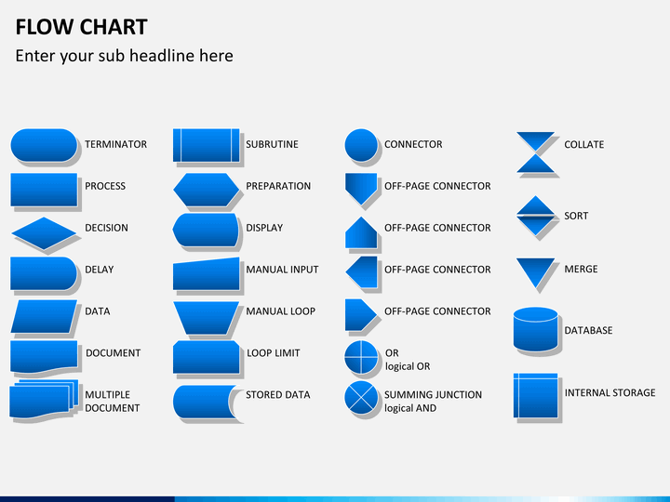
B
IDENTIFIED
MATERIAL VARIANCE
CREATE NTC
(Notice to Contractor)
DECLARE RETURN/S
DECLARE RETURN/S
C
RESOLVE
VARIANCE
Yes
WITH
COMMITMENT?
No
AUTOMATIC NOV
(Notice of Violation)

Slide 7
